Slide 1
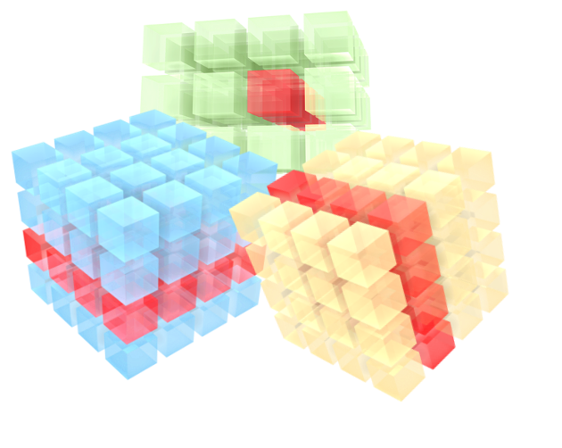
Analytics on Big Data Cubes in Science and Engineering
Peter Baumann
p.baumann@jacobs-university.de
Otoniel Campos
o.camposescobar@jacobs-university.de
Notes:
Good morning everyone! Hope you are having a great end of the week and thanks for coming to our presentation titled: ”Analytics on Big Data Cubes in Science and Engineering”.
My name is Otoniel Campos and I’m a PhD student at Professor Peter Baumann’s ​Large Scientific Information Systems Research Group aka. L-SIS where we deal with everything related to raster data and Big Data cubes.
Today I’ll present you how Data Cubes can make your life easier when analyzing raster data, or data aligned in some n-D grid like weather, geographic, medical, space so on.
Hopefully after this presentation you’ll feel more comfortable when discussing the nature of Big Data cubes with friends, family, possible employers etc.
Ok, so without further do let’s begin.
If they ask…
Raster Data
Is a tensor of cells (or pixels) organized into rows and columns (or a grid) where each cell contains a value representing information, such as temperature.

Slide 2
What questions will we answer?
How does big data look like?
What are multidimensional arrays (aka. Data Cubes)?
How can we model multidimensional arrays?
Which tool can we use to analyze these cubes?
What applications can be done with data cubes?
What topics can you choose?
Notes:
Here are the questions that will be addressed in this presentation:
We will first start with:
[CLICK]
How does big data look like; we’ll look how data engineers and software engineers try to find structures to relate all data in a meaningful way.
[CLICK]
2. Next, we will talk about what exactly multidimensional arrays are; or as you may know them through their much cooler name Data Cubes; and how can they simplify our life when analyzing Big Data.
[CLICK]
3. We will then talk about how can we model these arrays in a way a computer can process it and we can get meaningful insight out of it.
[CLICK]
4. We’ll introduce a tool that you can use freely to analyze Big and Small Data if you’re ever in the need to do it. Disclosure it’s called rasdaman and Prof. Baumann made it.
[CLICK]
We'll continue with
5. What are some of the applications that can be done when using these data cubes.
[CLICK]
6. And finally, if you’re brave enough you can pick one of our current research topics for your poster presentation for this class.
OK, now if you ready let’s begin.

Slide 3
What is Big Data again?
The term “Big Data” is a contemporary shorthand characterizing data which are too large, fast-lived, heterogeneous, or complex to be understood and exploited.
Data toooo Big to manage.
It is a cross-cutting challenge affecting storage and processing, data and metadata, servers and clients and mash-ups.
This data is essential for today’s digitalized world! It gives company’s the business edge they need, science relies on it to explain phenomenon etc.
Source: https://link.springer.com/chapter/10.1007/978-3-319-65633-5_5
Notes:
We will once again for 100000th time define what Big Data means to us.
When I was a master student @ Jacobs, well last year XD, every courses like Data Analytics, Big Data Challenge class and what-not, defined what Big Data is. Some of that we understood and some other we just memorized it for the exam. Let me yet give you our research’s group de facto answer.
[CLICK]
The term “Big Data” is a contemporary shorthand characterizing data that is too large, fast-lived, heterogeneous, or complex to be understood and exploited.
[CLICK]
Which translated in English means data too big to manage.
[CLICK]
Manage in the sense that it’s much bigger than our RAM’s capacity and cannot be processed by a normal human being’s laptop or desktop CPU (well at least not the ones with small wallets). So we cannot carry it around easily.
“It is a cross-cutting challenge affecting storage and processing, data and metadata, servers and clients and mash-ups.”
If they ask…
A mash-up (sometimes spelled as one word, mashup) is a Web page or application that integrates complementary elements from two or more sources.
This data is very hard to model. We cannot use a recipe to analyze it every single time and get the same results.
[CLICK]
In today’s world this data is essential. It gives the business edge for companies in an everyday more competitive environment, science is relying more and more on this data to explain natural phenomenon such as rain, the cosmos and many other.
Source: https://link.springer.com/chapter/10.1007/978-3-319-65633-5_5

Slide 4
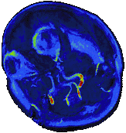
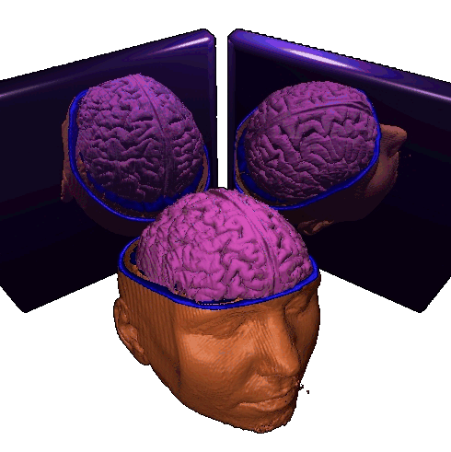
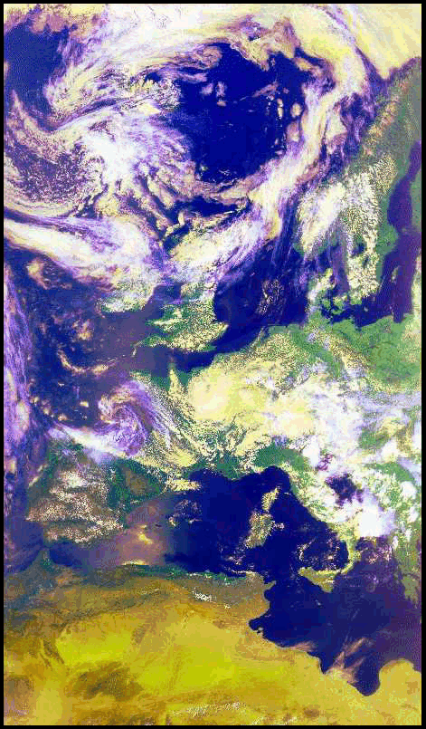

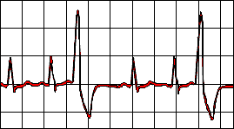
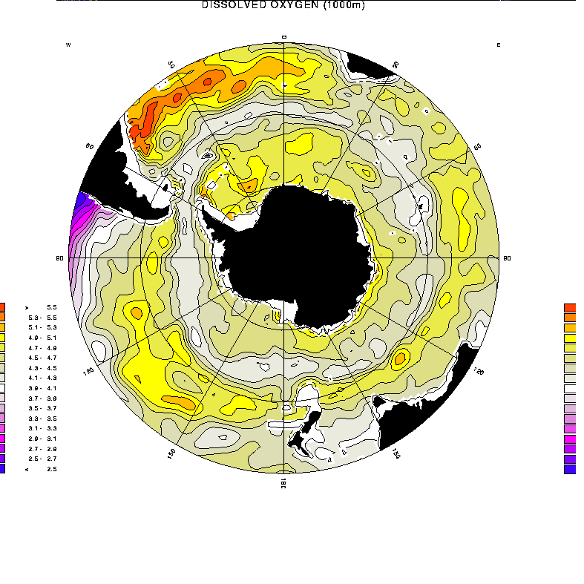
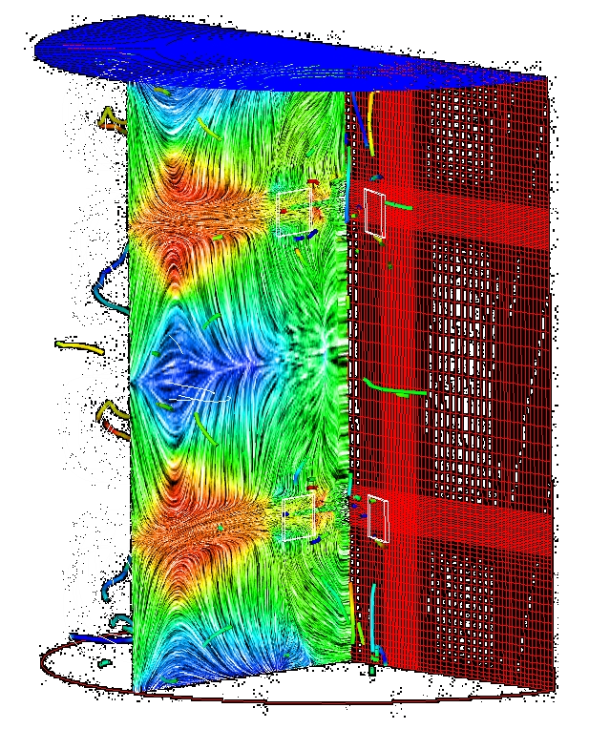
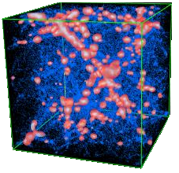
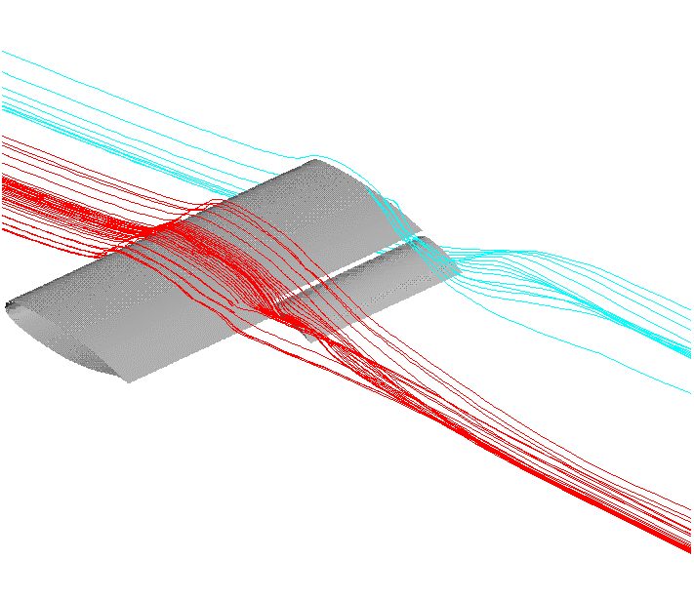
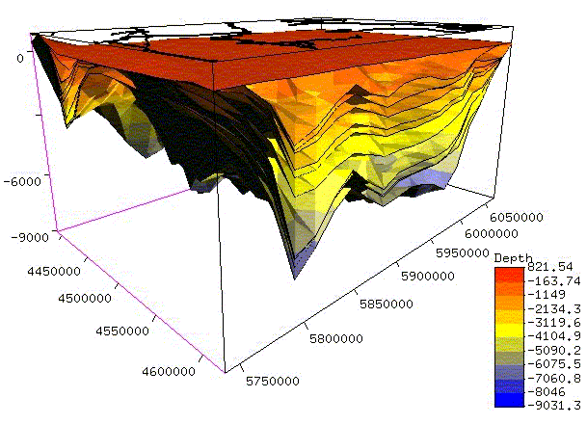
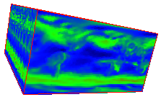
Big list of who uses this data
Life Sciences: Pharma/chem, healthcare / bio research, bio statistics, genetics, ...
Earth Sciences: Geodesy, geology, hydrology, oceanography, meteorology, remote sensing, ...
Space Sciences: Astronomy, planetary science, astrobiology, ...
Engineering: Simulation & experimental data in automotive / shipbuilding / aerospace industry, turbines, process industry, ...
Management/Controlling: Decision Support, OLAP, Data Warehousing, financial risk analysis, ...
Notes:
Let’s see who else uses this data.
Read the list very quickly.

Slide 5



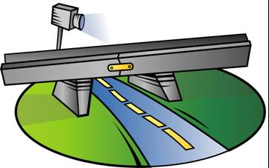
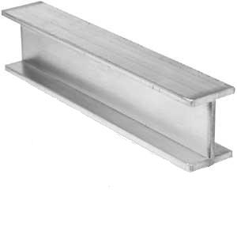
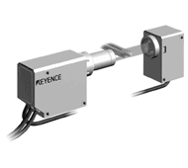
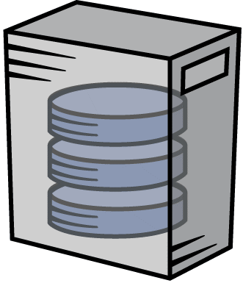

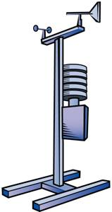

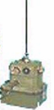

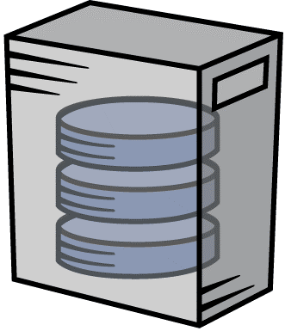
Where do we get all this data?
sensor feeds
simulation data
Big Data server
Notes:
And where do we get all this data? We‘ll from almost everywhere from very sophisticated apparatus like satellites, drones, surveillance cameras and what-not.
To barometric sensors and thermometers for weather data; and of course last but not least simulation data generated from machines,
In its RAW form all this data is useless;
[CLICKx3]
but once we process through a Big Data server we can actually get insight from it that‘s what we are looking for.

Slide 6
How does this data look like? Structural Variety in Big Data
Stock trading: 1-D sequences (i.e., arrays)
Social networks: large, homogeneous graphs
Ontologies: small, heterogeneous graphs
Climate modelling: 4D/5D arrays
Satellite imagery: 2D/3D arrays (+irregularity)
Genome: long string arrays
Particle physics: sets of events
Bio taxonomies: hierarchies (such as XML)
Documents: key/value stores = sets of unique identifiers + whatever
etc.
Notes:
Now let’s talk on how to model this data. In this very, very small list of possible examples of Big data we try to model the data using a data structure taken from programming languages. For example, stock prices are 1-D time series of data that can be represented as an array. We have social networks that can be represented as graphs and so on. By modelling data this way we make it easier to process it and later to get insights for it.

Slide 7
Fundamental Information Categories
Sensor, image [timeseries], simulation, statistics data.
sets + hierarchies + graphs + arrays
Notes:
Following previous examples we can see that we can model the data as sets, hierarchies, graphs and arrays.
Throughout time there have been many database systems that have been created to handle these data structures.
For example
SPARQL and RDF to model graph. Rasdaman for arrays and so on.
[CLICK]

Slide 8
MODELING MULTIDIMENSIONAL ARRAYS
Notes:
Now that we have gone this far, let’s see we can model it.

Slide 9
SQUARE 1: What are multidimensional arrays?
A multidimensional array is a set of elements ordered in space (discretized i.e. we use integers).
The number of integers used to refer to a particular position in space is called dimension, or dimensionality. E.g. [3,4,5] needs 3 integers, so this is a 3-dimensional array, [2,-1,5,-6] is 4D, and so on.
An array element is called a cell, and it is positioned in space through its coordinate e.g. [3,4,5] refers a cell in a 3D space.
Notes:
Let’s start with the basics; what the H is a multidimensional array? (pause)
[CLICK]
A multidimensional array is a set of elements ordered in space. Here I highlighted space to emphasize that the way we reference an element in this so called “space” is by using integers.
Much like an array in any programming language.
Ok, now we know how to reference an element in space. Let’s move on.
[CLICK]
As we said we use integers, much like how a house #, street, state and country defines someone's address. In this example we need house #, street, state and country; four pieces of information in order to correctly locate a person/business on Earth. Likewise, multidimensional arrays use these “pieces of information” in order to identify an element in space. And the number of pieces of information, in this case integers, needed to refer to a particular position in space is called the array’s dimension. For example, [3,4,5] refers to a 3-dimensional array; and [2,-1,5,-6] refers to a 4D array.
[CLICK]
Finally, we have the array elements. An array element in this context is called a cell, and it is positioned in space by using its coordinates. Like for example: [3,4,5] refers to an array element, or cell, in a 3D space.
Ok, too much text already so let’s look at it with a picture.
NOTE: Maybe create a game to make it more engaging.

Slide 10
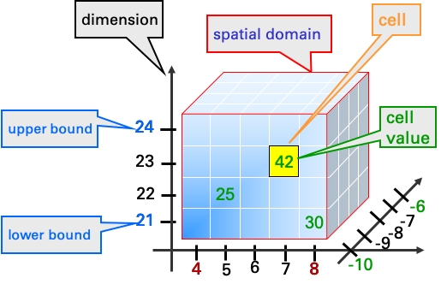
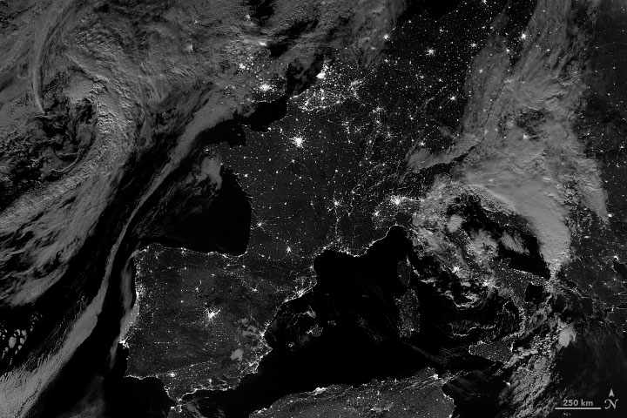
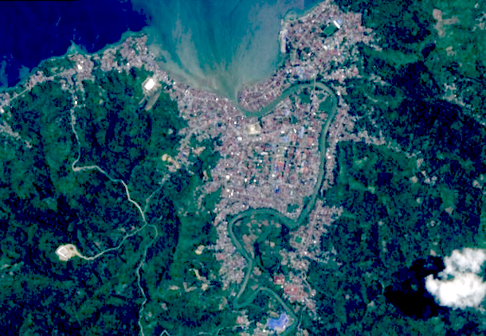
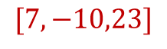
The Array Data Model
x [4:8]
y [-10:-6]
z [21:24]
Cell Values:
(Single value) Intensity value in a grayscale image. E.g. 3,4,0-255.
(Composite value) Integer triples for red, green and blue components of a true-color image.
Not
defined
$$[7,−10,23]$$
z
y
x
Notes:
Ok, much better. So what is happening here?
From left to right, we first see these upper bound and lower bound boxes. They represent where does the array starts and ends, if you notice it doesn’t have to necessarily start from 0 or 1. I can start from any integer, including negative numbers.
Next, we have the dimension as we mentioned before a dimension is the number of integers needed to refer to a particular position in space, you can think of them like the axes in a coordinate system. In this case, we are representing a 3D space so we will need 3 components
X
[CLICK]
Y
[CLICK]
and Z.
[CLICKx5]
So in this case we can refer a cell in this 3D space by using coordinates [7,-10,23].
Now let’s talk about spatial domain. In this example, you can see that we limited that size of our cube by defining upper and lower bounds for each dimension. In this example, we can see that for the x-axis we have defined the lower bound as 4 and the upper bound as 8.
[CLICK]
For the y-axis we have defined the lower bound as -10 and the upper bound as -6.
[CLICK]
And finally, for the z-axis we have defined the lower bound as 21 and the upper bound as 24.
Only cells whose coordinates are within the ranges of each dimension are defined. So if we would like to refer to a cell with coordinates [7,-5,23].
What would happen?
[CLICK until yellow box is drawn]
An error or exception would be raised; since -5 is not in the spatial domain for the y-axis.
[CLICK]
Ok; now finally let’s talk about the cell and cell value. As we mentioned before, a cell is an element in the multidimensional array. And a cell value is, as its name suggests, the value of this cell.
[CLICK]
This can be a single value such as an intensity value in a grayscale;
[CLICK]
or a composite value such as triples of red, green and blue components of a true-color image.
[CLICKx2]
And much more. In rasdman, you can even define your own cells value structure, known as array base type, to include additional data such as temperature, humidity, etc. As long as all cells have the same structure the sky is the limit.

Slide 11
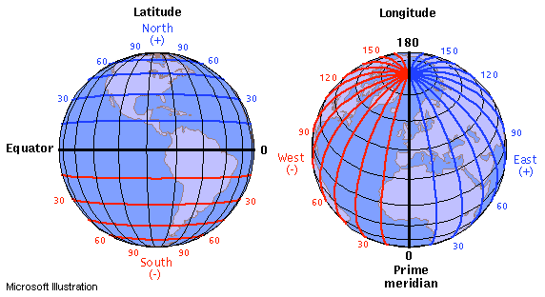
Why don’t all spatial domains start at 0?
Some applications locate data by using indexes != than 0.
The space is discretized. But we can still use negative numbers!
Spatial Domain:
[Lat (-90:90), Lon (180:180)]
[-30,-60]
Notes:
Before we continue, I would like to point one thing out.
Going back a bit to the spatial domain section.
You might ask yourselves, why going through all the trouble of defining certain numbers for upper and lower bounds and not simply start from zero?
[CLICK]
Well, the answer is that there are some applications where the bounds might start at a negative number and end in a positive number, such as geography.
[CLICK]
If you recall, the space we use is discretized so only integers allowed.
[CLICKx2]
Nevertheless, we can still use negative numbers to represent geographic coordinates. Latitude and longitude are measured in degrees ranging from 90 degrees north and 90 degrees south for latitude and 180 degrees east to 180 west for longitude.
[CLICKx2]
For example, the ordered pair 30 degrees SOUTH and 60 degrees WEST can be represented as [-30,-60] in a multidimensional array; so we found a way to represent a geographical location in our MDD array.

Slide 12
Array Analytics
Array Analytics := Efficient analysis on multi-dimensional arrays of a size orders of magnitude above evaluation engine‘s main memory
Essential data property: n-D Cartesian neighborhood
Secondary: #dimensions, density, ...
Operations: Linear Algebra++
[EDBT/ICDT Array Databases Workshop, 2011]
Notes:
Now back to our story...
[CLICK]
Up to this point we established a way to define multidimensional arrays now let's move to how we can analyze them.
Array analytics is the efficient analysis of these multidimensional arrays in orders of magnitude above main memory.
[CLICK]
What analytics are we talking about? In essence we want to know neighborhood. What is next to the red dot?
Other things we may want to know are the # dimensions in the array or the density and the data values of these neighborhood.
But we can go further, we can support linear algebra operations, matrix multiplication etc. And even further such as image processing and signal processing.
Let’s see what has been done up to this point.

Slide 13
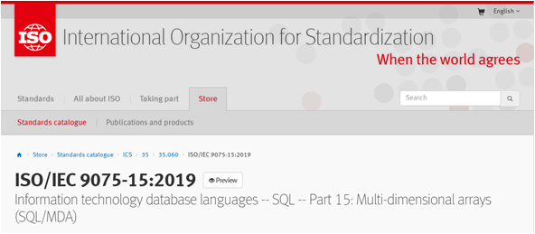
create table LandsatScenes( id: integer not null, acquired: date, scene: row( band1: integer, ..., band7: integer ) mdarray [ 0:4999,0:4999] )
select id, encode(scene.band1-scene.band2)/(scene.band1+scene.band2)), „image/tiff“ ) from LandsatScenes where acquired between „1990-06-01“ and „1990-06-30“ and avg( scene.band3-scene.band4)/(scene.band3+scene.band4)) > 0
[SSDBM 2014]
Notes:
Here’s an example of an SQL query supporting operations on multi-dimensional arrays. It’s currently included in the ISO/IEC 9075-15:2019 (International Organization for Standarization) on SQL Part 15.
We can see two queries the first one creating a table with a satellite image defined as a multidimensional array object of 5000x5000 pixels.
On the second query we can see a select clause that defines a projection of that same multidimensional array encoded as a tiff. As well as a where clause that includes an avg operation on the bands of this MDD object.
So the database community is supporting SQL on MDD arrays.
Now let’s have a look at such a system that provides a built from the ground approach and leave us with the good stuff. There is.

Slide 14
INTRODUCING rasdaman
Notes:
Now let’s introduce this tool called strangely rasdaman.

Slide 15
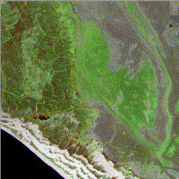
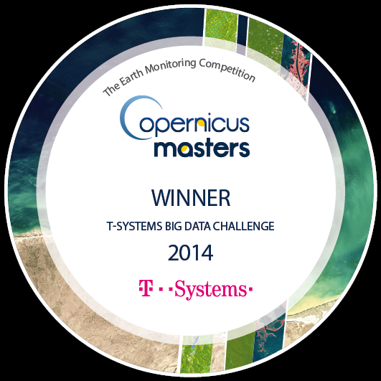
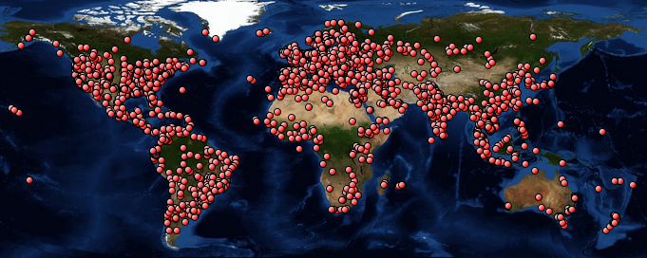




rasdaman
= „raster data manager“: SQL+ n-D arrays
Scalable parallel “tile streaming” peer architecture
Mature, in operational use
Ex: www.earthserver.eu
ESA 2017: “world leading environment”, “standard working horse for OGC standardization on these innovative data access interfaces“
www.rasdaman.org
Notes:
Rasdaman or “raster data manager” is an array database management system developed and maintained by Prof. Baumann. It combines the worlds of SQL and multidimensional array modelling in one easy to use platform. It is free to use in its community edition.
It’s a very scalable system that takes advantage of parallel “tile streaming” to process raster data.
It’s a very mature platform with more than 20 years of development; so it’s safe to say that it’s pretty much mature and you can see by accessing the earthserver initiative through this link.
It’s been acknowledged by the European Space Agency as ”world leading environment”, ”standard working horse for OGC (Open Geospatial Consortium) standardization on these innovative data access interfaces”.
If they ask…
OGC
an international voluntary consensus standards organization, originated in 1994. In the OGC, more than 500 commercial, governmental, nonprofit and research organizations worldwide collaborate in a consensus process encouraging development and implementation of open standards for geospatial content and services, sensor web and Internet of Things, GIS data processing and data sharing.
The idea is to provide a platform with powerful tools available for simple use by non-experts while not constraining complex tasks for experts just adds to the complexity.

Slide 16
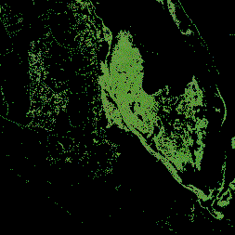
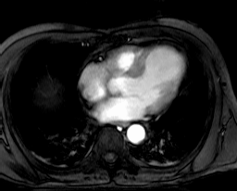
Array Queries in a Nutshell
trimming & slicing
select c[ *:*, 100:200, *:*, 42 ] from ClimateSimulations as c
result processing
select img * (img.green > 130) from LandsatArchive as img
search & aggregation
select mri from MRI as mri, masks as m where some_cells( mri > 250 and m )
format conversion
PNG
PNG
select encode( img.red, "image/png " ) from LandsatArchive as img
HDF
rasdaman DB
HDF
NetCDF
NetCDF
Notes:
Following from the SQL part-15 ISO standard. Let’s see rasdaman’s approach to executing select clauses.
We first can see trimming and slicing operation.
In rasdaman we can achieve this by specifying the dimensions we would like to include and rasdaman will return this section of the MDD for us.
Result processing
We are also able to process a result in the select clause and multiply an element of a composite data value.
Search and aggregation
Where clauses are also part of the game. We can first do joins and then called build in functions that evaluate specific cells like in the case of this some_cells operation.
Format conversion
And finally format conversion we can ad-hoc requests and have rasdaman deliver it as a picture among other formats.
Reducing the spatial domain of an array while leaving the cell values unchanged is called trimming. Array dimension remains unchanged.
A section allows to extract lower-dimen­sional layers (“slices”) from an array.

Slide 17
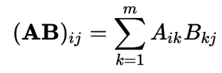
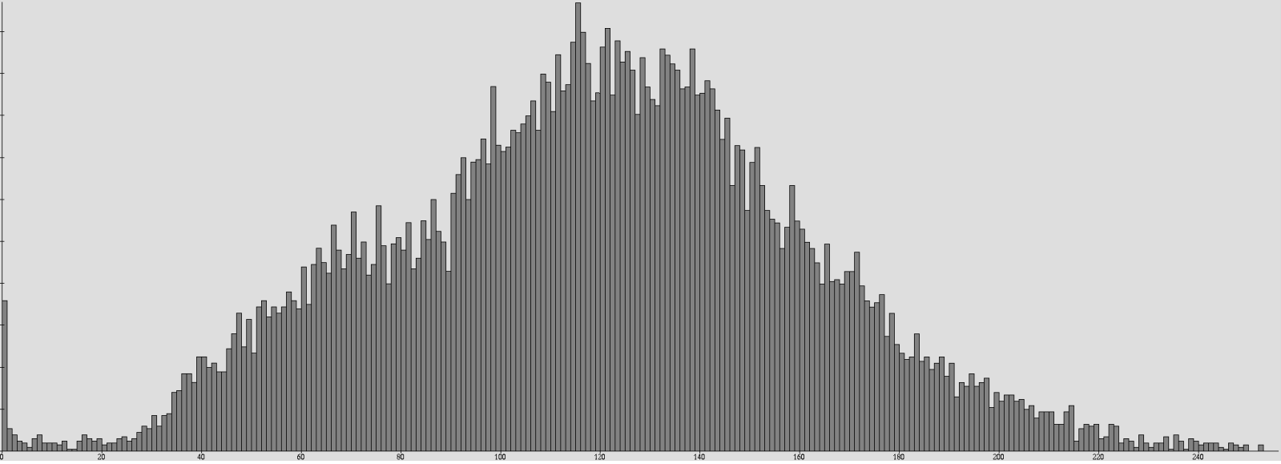
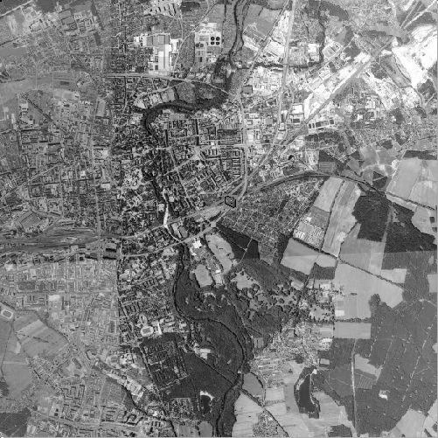
Linear Algebra in Array Queries
Matrix multiplication
Histogram
select mdarray i in [0:m], j in [0:p] values condense + over k in [0:n] using a [ i, k ] * b [ k, j ]
from matrix as a, matrix as b
select mdarray bucket in [0:255] values count_cells( img = bucket )
from img
Notes:
Linear algebra operations are also covered; by combining condense operators we can successfully execute matrix multiplication on multidimensional arrays. So the language is powerful enough to express these operations.
Histograms are also available right off the bat.

Slide 18
ARCHITECTURE
Notes:
Now let’s talk of the service architecture of rasdaman

Slide 19
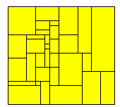
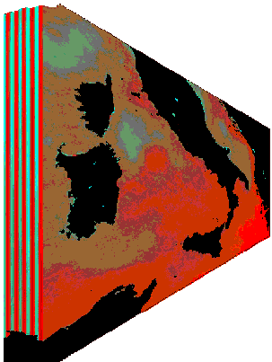
Adaptive Transparent Partitioning („Tiling“)
Any tiling, canned into strategies [ICDE 1999]
regular directional nonaligned area of interest
rasdaman storage layout language [IEEE SSTDM 2010]
insert into MyCollection values ... tiling area of interest [0:20,0:40], [45:80,80:85] tile size 1000000
Notes:
Now dealing with TB or PB of data is no easy feat. Starting by the fact that our RAM is not that big, we need a way to partition data in a way that RAM can handle it. There are various strategies like regular, directional, nonaligned and even area of interest in order to better adapt to the nature of the data.
On the picture below we can see how these tiles are represented in rasdaman and how data is partitioned.

Slide 20
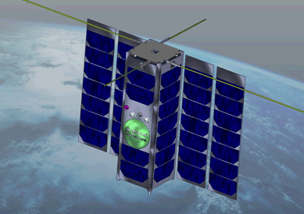



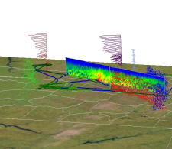
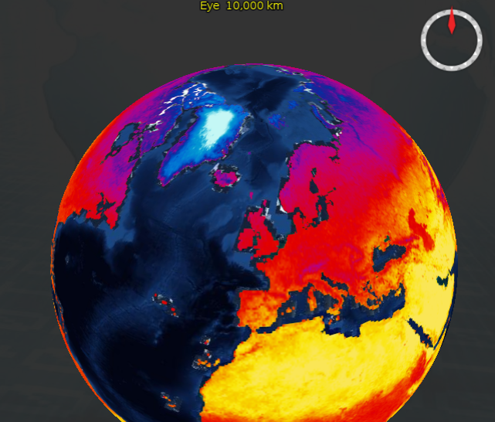
Parallel, Distributed Processing
max( (A.nir - A.red) / (A.nir + A.red) ) + avg( B.green ) + max( (C.red + C.green + C.blue) / 3 ) + max( (D.nir + D.red) / 2 )
Dataset D
1 query  1,000+ cloud nodes
[VLDB BOSS 2016] [ACM SIGMOD DanaC 2014]
Dataset C
Dataset A
Dataset B
Notes:
Distributed processing is also possible under rasdaman feature umbrella.
It can go as easy giving one partition to each core, an embarrassingly parallelization.
But there can be even smarter
Rasdaman’s approach
Analyze query DA (immediately),
Where does the data sit?
Minimize transport along the connections (red lines)
Make a satellite a federation.
PENDING!!

Slide 21
APPLICATIONS
Notes:
We have a model and a system, now let’s put them into practice.

Slide 22

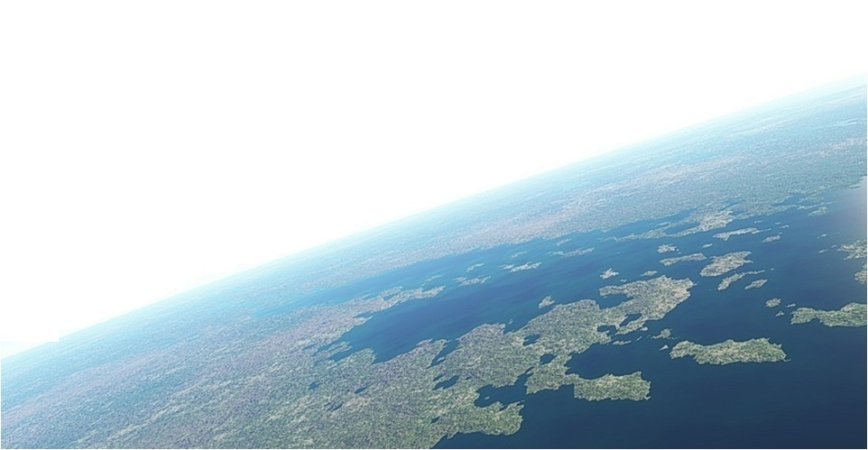
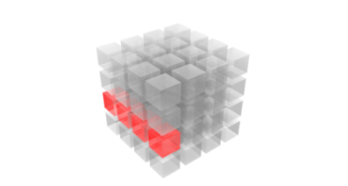
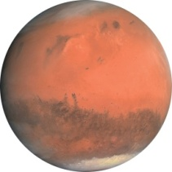
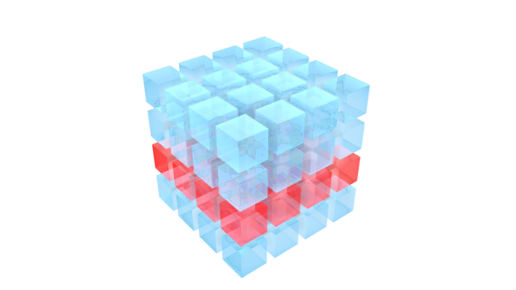
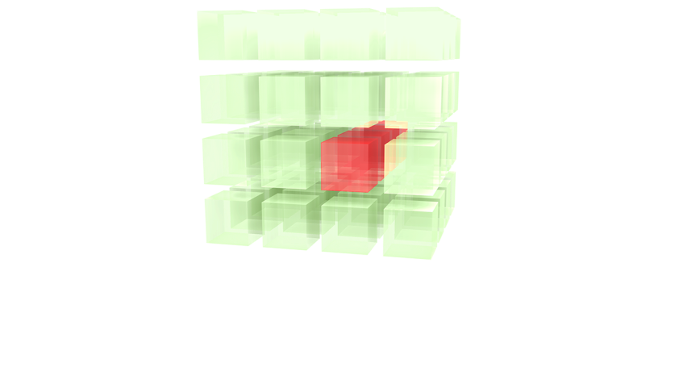
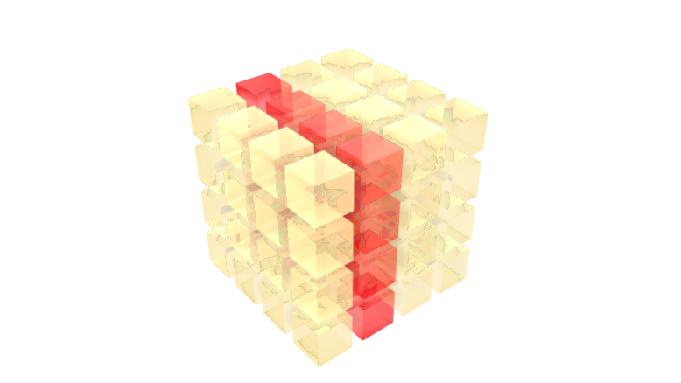

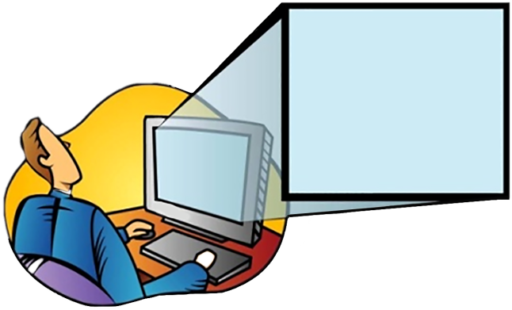
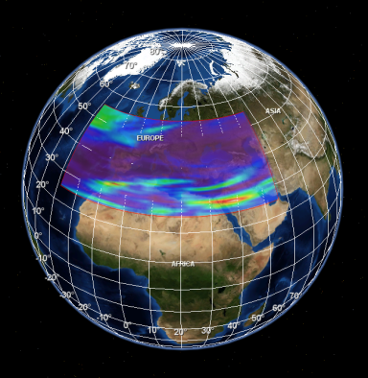

Starting Point: Earth Server Initiative
Agile Analytics on x/y/t + x/y/z/t Earth & Planetary datacubes
Rigorously standards: OGC WMS + WCS + WCPS
EU rasdaman + NASA WorldWind
>100 PB federated
http://www.earthserver.eu/
Notes:
ask any question, any time, on any size
Researchers from Europe, the USA and Australia have teamed up to rigorously materialize the datacube concept. EarthServer has established client and server technology for such spatio-temporal datacubes. The idea was to provide agile analytics
rasdaman, enables direct interaction, including 3D visualization, what-if scenarios, common EO data processing, and general analytics
https://link.springer.com/chapter/10.1007/978-3-319-65633-5_5
@Inbook{Baumann2018,
author="Baumann, Peter
and Rossi, Angelo Pio
and Bell, Brennan
and Clements, Oliver
and Evans, Ben
and Hoenig, Heike
and Hogan, Patrick
and Kakaletris, George
and Koltsida, Panagiota
and Mantovani, Simone
and Marco Figuera, Ramiro
and Merticariu, Vlad
and Misev, Dimitar
and Pham, Huu Bang
and Siemen, Stephan
and Wagemann, Julia",
editor="Mathieu, Pierre-Philippe
and Aubrecht, Christoph",
title="Fostering Cross-Disciplinary Earth Science Through Datacube Analytics",
bookTitle="Earth Observation Open Science and Innovation",
year="2018",
publisher="Springer International Publishing",
address="Cham",
pages="91--119",
abstract="With the unprecedented increase of orbital sensor, in situ measurement, and simulation data there is a rich, yet not leveraged potential for obtaining insights from dissecting datasets and rejoining them with other datasets. Obviously, goal is to allow users to ``ask any question, any time, on any size'', thereby enabling them to ``build their own product on the go''.",
isbn="978-3-319-65633-5",
doi="10.1007/978-3-319-65633-5_5",
url="https://doi.org/10.1007/978-3-319-65633-5_5"
}

Slide 23
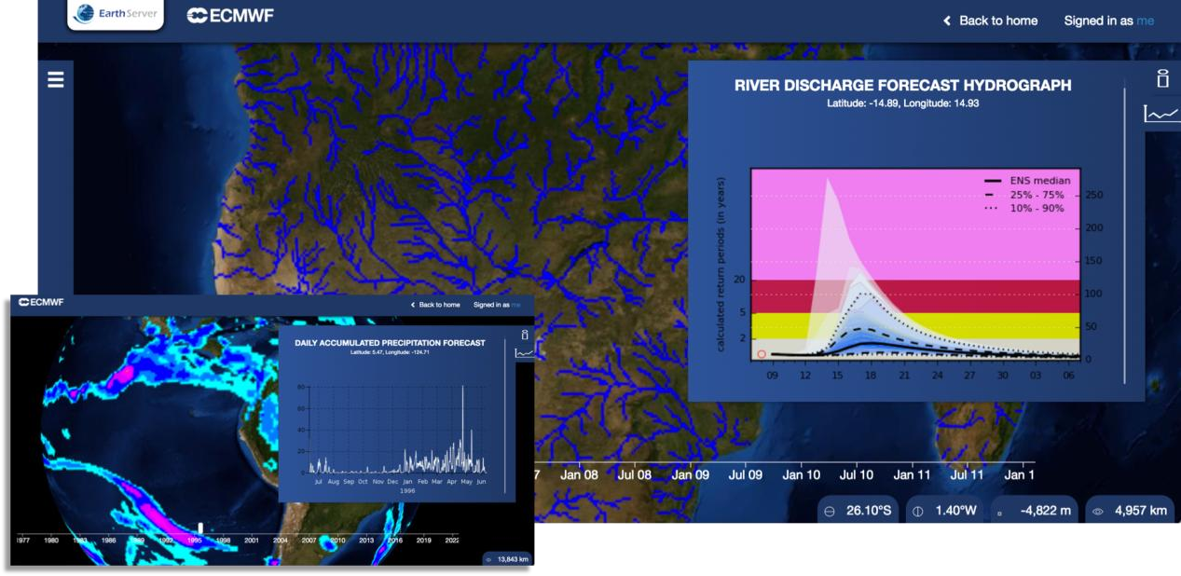
River Discharge
[EarthServer/rasdaman]
Notes:
Here with the help of EMCWF (European Centre for Medium-Range Weather Forecasts) they wanted to represent river discharge in a spatio temporal way and obtain statistics like:
- Daily accumulated precipitation forecast.
- River discharge forecast hydograph.

Slide 24
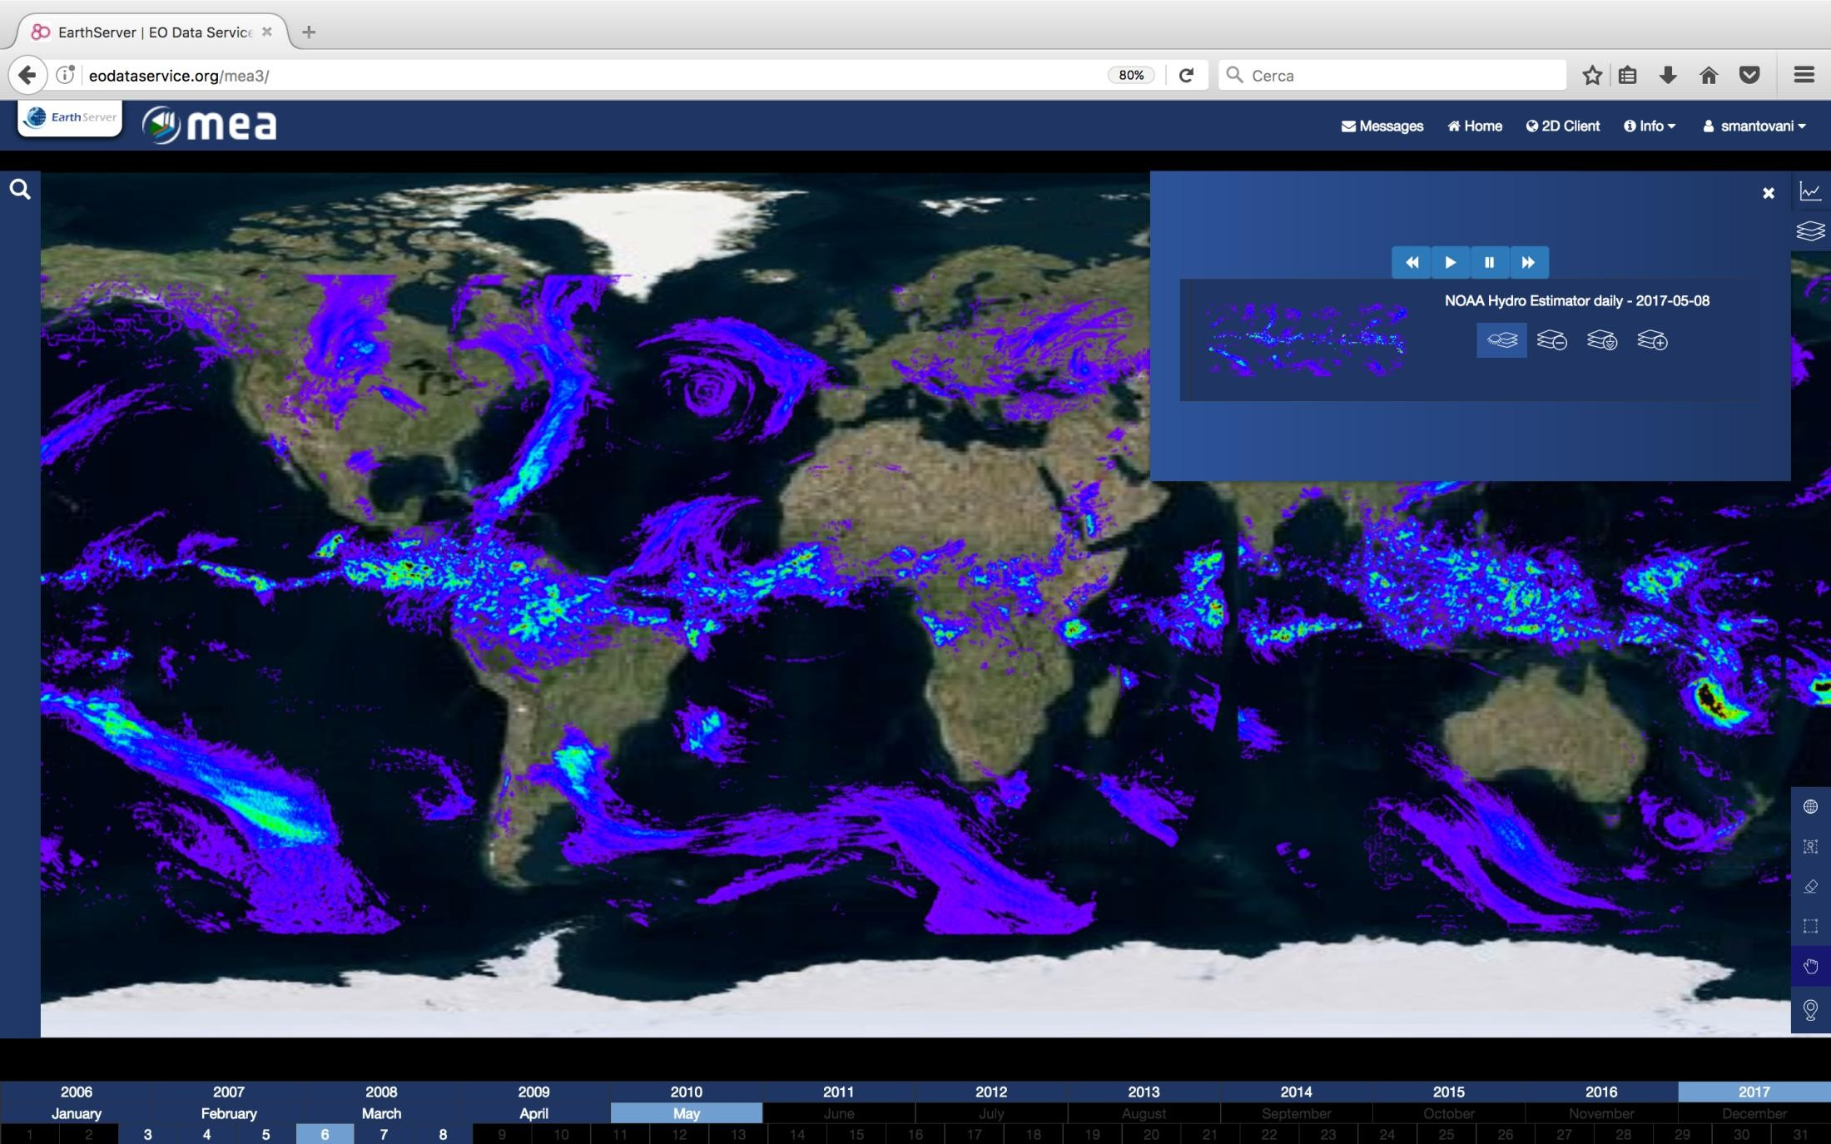
Daily Hydro Estimator
[EarthServer/rasdaman]
Notes:
Also for example how much water is in the atmosphere.

Slide 25
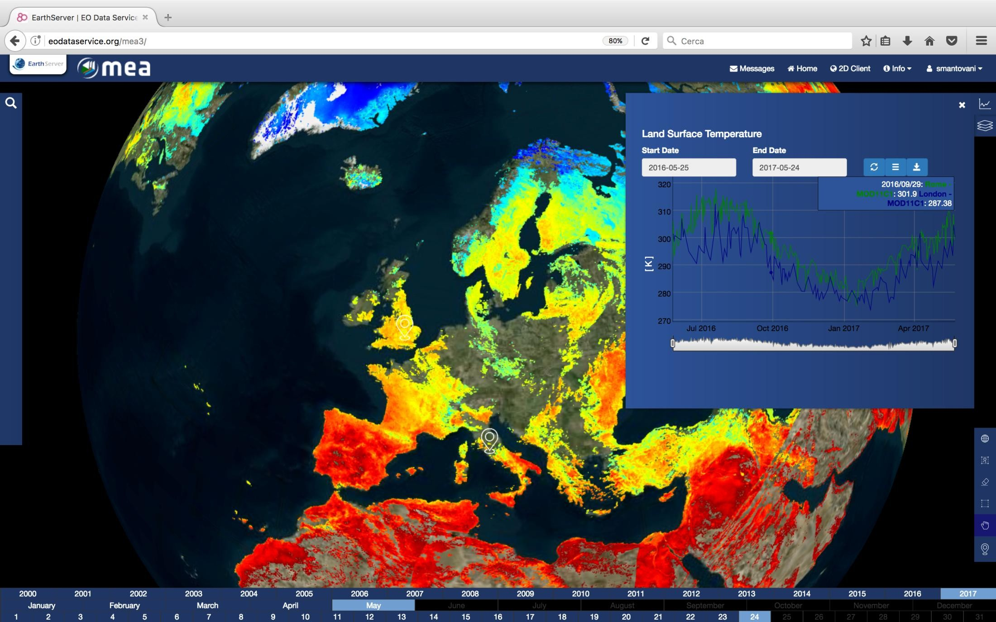
Land Surface Temperature, Cloudfree
[EarthServer/rasdaman]
Notes:
And Land and surface temperature over times this can all be represented with data cubes.

Slide 26
DEMO - https://standards.rasdaman.com
Notes:
We have a model and a system, now let’s put them into practice.
3D, 4D demo.
10 -15 demos
/demo_webgl.html

Slide 27
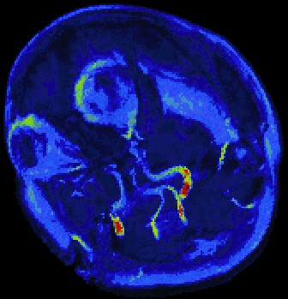

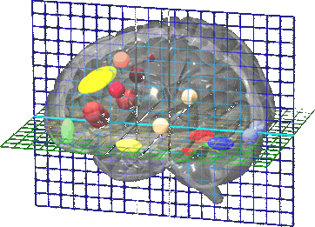
Human Brain Imaging
Research goal: to understand structural-functional relations in human brain
Experiments capture activity patterns (PET, fMRI)
Temperature, electrical, oxygen consumption, ...
lots of computations „activation maps“
Example: “a parasagittal view of all scans containing critical
Hippocampus activations, TIFF-coded.“
select tiff( ht[ $1, *:*, *:* ] )
from
HeadTomograms as ht, Hippocampus as mask count_cells( ht > $2 and mask )
/ count_cells( mask )
> $3
where
$1 = slicing position, $2 = intensity threshold value, $3 = confidence
Notes:
Here we an example of human brain imaging where the goal is understanding the structural-functional relations in the human brain.
Here we scanned a human brain while doing some task like calculating the square root of a number, we obtained the data through some PET, fMRI scan we after processing we obtain a nice tiff image that shows the areas of the brain that were activated while performing this task; these are called activation maps.
In the query we sample query we iterated over over all images and we found the ones that matched the criteria. You can see here that there were 3 areas that were activated for this task we can start asking ourselves questions like:
Are these areas always activated together?
To what brain organs do they belong?
Etc.

Slide 28




Gene Expression Analysis
http://urchin.spbcas.ru/Mooshka/
[Samsonova et al]
Gene expression = reading out genes for reproduction
Research goal: capture spatio-temporal expression patterns in Drosophila
genes
select encode( scale( {1c,0c,0c}*e[0,*:*,*:*]
+{0c,1c,0c}*e[1,*:*,*:*]
+{0c,0c,1c}*e[2,*:*,*:*], 0.2),„image/jpeg“)
from EmbryoImages as e
where oid(e)=193537
Notes:
In the area of life sciences we also have Gene Expression Analysis; in case we will analyze the evolution of embryos from a Drosophila melanogaster, commonly known as fruit fly, and see the gene activation and deactivation of genes. So we take the embryos, slice them and then put them some specific light conditions they get illuminated and we can see parts of the body that are active and non-active. This results in an image that is much easier to handle than its earlier counterparts.
In an array database query we can treat it as a 4-dimensional cube where the volume of the embryo evolves over time and then we can perform queries on this 4D object.

Slide 29



Cosmological Simulation
Coupled simulation: particle + fluid
Dark matter
baryonic matter (stars, gas, dust, …)
Results: 3D/4D cutouts from universe
Eg, 64 Mpc³
(1 pc = 3.27 light years)
Screenshots: AstroMD [Gheller, Rossi 2001]
Notes:
Let’s go to space.
In here we get simulation data from dark matter and baryonic matter. How they simulate it and obtain results I don’t know, but what I do know is that we will get a 3D or 4D cutout of the universe.
Here we can see a tool called Astro MD that was made some time by Prof. Baumann and other partners from Jamaica and Italy such cutouts and we can ask questions like:
What is the behavior of stars and super clusters?
What is the behaviour of the empty space in between?

Slide 30




My Research DeepRain: ML for Rain Forecast
Goal: improve rain prediction for mountainous areas
Approach: ML + Array DBMS
numerical weather forecast models + precipitation radar + lightning + station measurements + topography
Lead: Jülich Research Centre, Germany
https://www.deeprain-project.de/en/welcome/
Notes:
Let me talk to you a bit of my research.
So the main goal is to improve rain prediction for mountainous areas, for instance the Hartz mountains near Hannover.
For that we plan on having a ML + Array DBMS approach where can model numerical weather forecast models.
We are currently evaluating ways to do it via UDFs (or User Defined Functions), enhancing the current query language to allow recursion or simply build it from the ground up to support machine learning algorithms such as Deep Neural networks, SVD etc.
The lead for this project is Julich Research Centre and we are using data from the Deutsche WetterDienst (dinst) or German Weather Service; if you want to find more of this project please follow the link below, we try to keep it updated as much as we can so you can see how it evolves.
https://www.deeprain-project.de/en/welcome/

Slide 31
State of the Art
Array Databases
SciDB: Postgres kernel with User-Defined Functions.
Oracle GeoRaster
Ad-hoc implementations
Google Earth Engine
Open Data Cube: Python programming.
Command-line tools, libraries:
Hadoop, Spark
Research Data Alliance 2018 report: „rasdaman can be 304x faster“
rasdaman‘s key USPs:
flexibility
performance & scalability
security
federation
open standards
Notes:
Here we have a quick overview of the current state of the art of multidimensional array management using various methods.
Starting with Array Database that were built from the ground up to support arrays. We can see we have Sci-DB with its user defined functions, Oracle GeoRaster.
Going through Ad-hoc implementations such as Google Earth Engine and Open Data Cube that has Python programming.
Also command-line tool libraries such as Hadoop and Spark.
All this information is available on the 2018’s Research Data Alliance. Spoiler alert rasdaman can be 304x faster.

Slide 32
RECAP
Notes:
We have a model and a system, now let’s put them into practice.

Slide 33

Conclusion & Outlook
Arrays everywhere: science, engineering, business, ...
Big Data  analytics in server
rasdaman:
declarative query language, seamlessly integrated
Optimization, distributed processing  high performance
Datacube standards available for interoperability
Future:
Cost-based optimization of federated array queries
Machine Learning in Array Databases
Notes:
So to recap; arrays are everywhere as we saw before it not only helps us model and study data in a very intuitive way, but it also let’s us enhance some already existing data with metadata to get more meaningful insights that otherwise might be hard to study; such as adding elevation to a png image for rendering or modelling fruit fly embryo evolution over time.
We also so what tools can be used to analyze this data such is the case of rasdaman which is a declarative, high performance tool that you can download for free and use it anytime.
We also look at some standards that are currently available for interoperability between systems, and how the community is acknowledging and currently shifting to array support in SQL.
And finally what is the future looking like for array databases.
We can think about cost-based optimization of federated array queries.
And hopefully my contribution will be machine learning in Array Databases.

Slide 34
Topics to choose from
What are we looking for?
What is that?
Why is it good to have?
What are the standards?
What is the current state of the art?
1. Satellite image timeseries as datacubes
Starting point: P. Baumann, D. Misev, V. Merticariu, B. Pham Huu: Datacubes: Towards Space/Time Analysis-Ready Data.. In: J. Doellner, M. Jobst, P. Schmitz (eds.): Service Oriented Mapping - Changing Paradigm in Map Production and Geoinformation Management, Springer Lecture Notes in Geoinformation and Cartography, 2018

Slide 35
Topics to choose from
2. Database Language for Earth System Sciences
Starting point: D. Misev, P. Baumann: A Database Language More Suitable for the Earth System Sciences. G. Lohmann et al (eds.): Towards an Interdisciplinary Approach in Earth System Science. Springer 2015, doi:10.1007/978-3-319-13865-7
3. Big Data and Internet of Things
Starting point: P. Baumann: Big Data Meets Internet of Things: a Standards-Based Perspective. Proc. 2017 IEEE Intl. Geoscience and Remote Sensing Symposium, Fort Worth, USA, 23-28 July 2017
4. Array Database scalability
Starting point: A. Dumitru, V. Merticariu, P. Baumann: Array Database Scalability: Intercontinental Queries on Petabyte Datasets (system demonstration). Proc. 28th Intl. Conf. on Scientific and Statistical Database Management (SSDBM), Budapest, Hungary, July 18 - 20, 2016

Slide 36
Resources
https://tutorial.rasdaman.org/: SUPER EASY TUTORIAL for RASDAMAN!!!
https://standards.rasdaman.org/, https://earthserver.eu/webinars/: (Explains coverages).
www.earthserver.eu: Explains the EarthServer federation initiative.
http://www.faculty.jacobs-university.de/pbaumann -> Publications: Prof. Baumann’s Publications.
https://www.youtube.com/c/PeterBaumannRasdaman/videos -> Peter’s Youtube Channel (rasdaman installation, tutorials)

